Slide 1
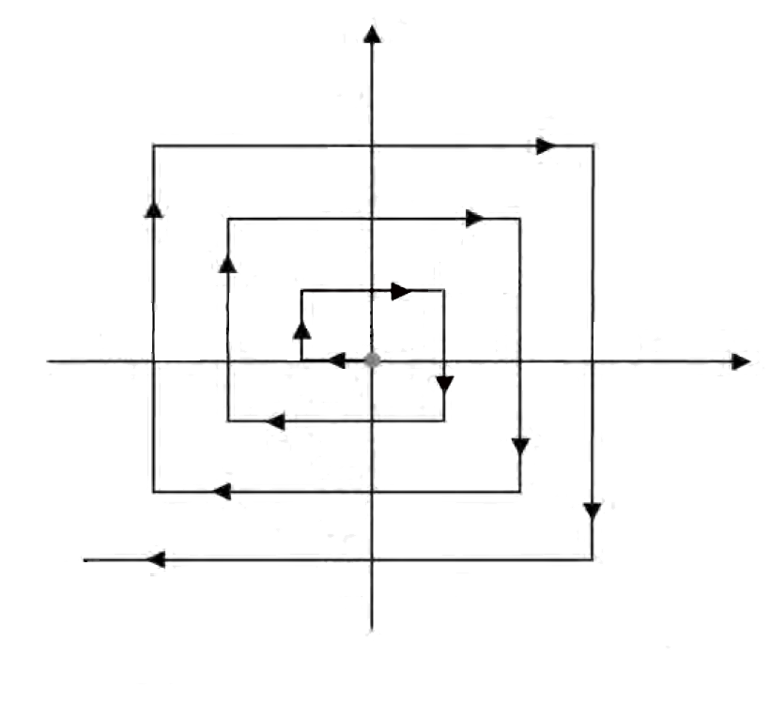
y
6I
4I
2I
5I
3I
I
Basis point
2I
4I
6I
x
I
3I
5I
7I
I: Search Interval

